Slide 1

Business Analytics Capstone Framework for Strategy
Anggi Firdian Saputra
25 August 2022

Slide 2
Strategy

Slide 3
Strategy Describe your proposed strategy
Make sure your strategy is clear, well-defined, and feasible
A single strategy is not sufficient to tackle this problem. So a multiple strategy approach is recommended. The strategy of ad-blockers threat is basically lies in creating a sustainable advertisement ecosystem, where there are two strategies:
Generating a much greater advertising experience for users to see the ads without pushing them, with the following points:
Tighten Quality of Assurance (QA) of advertisement content, where the ad’s content deliverable should be a gift, delightful, informative, meaningful, useful, invisible, inspirational, and indispensable part of product and service experiences, taking into the improvement of page load time so that it does not take a long time when load the page.
Executing A/B Testing on different ads experiences to each segment of user bases. To know the end-users preference, and deploy the result which new native ads appearance suit best for each segment.
Create GYF built-in ad-blocking to make end-users choose their own preference to prohibit the access of ads or not. If they are choosing to activate the GYF built-in ad-blocking, GYF analytics still can fetch the end-users cookies, links clicked, and other data to do further analytics. For end-users who already used 3rd party ad-blockers, we are sending the prompt that asks whether they will turn off the old one and activate GYF built-in ad-blocking considering their data security is crucial to unknown 3rd party.
The Ambidextrous Tactics to boost the strategy itself, with the following points:
Create a solid culture of ads team members. By building an execution culture that lays out key decision, action, support the model and execution plan with effective incentives and controls, which take agreement and commitment are sought and rewarded consideration. This culture would lead to successful strategy execution and avoid members turnover challenges.
Create a collaborative ecosystem all across search engine companies and publishers by holding a consortium to ‘drive’ the industry that potentially becomes an industry barrier, as for the case to standardize the ads content to not be so invasive and too bloated.
If these trials fail to provide a desirable result, an analysis must be conducted on the most feasible solutions out of the following 3 options: Charging the customers vs Paying to get whitelisted vs Paying anti adblocking companies. In the end we must choose the most economic option of the three.
Although it would not be a good idea to pay the adblockers to get whitelisted since there is a chance of some other adblocker that might block our content. This should be adopted only as a short term solution.

Slide 4
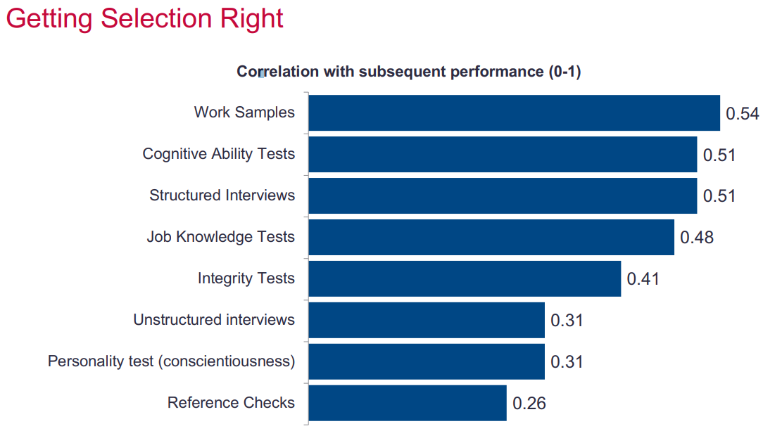
Strategy Application Exercise 2 – Hiring a Team Leader (Optional)
Based on the information provided in Application Exercise 2, describe here why you would hire Carrie Candidate or Peggy Prospect to be the second-in-command of the DATA Team.
As the leader of the DATA Team at GYF, I am looking for a new Senior Associate Director for Digital Advertising Strategy. This person will be my second-in-command as I develop and implement my strategy for addressing the problem of adblocking.
I would hire Peggy Prospect as a new Senior Associate Director for
Digital Advertising Strategy, because apart from having excellent
academic scores, she also has prior experience in the relevant field
and that experience might come in handy to save time and money in
our strategy application.
Although she scores based on metric assessment results a bit low on
the cognitive test than Carrie Candidate, the other test parameters
show promising prospects. She already has knowledge of what kind of
work is expected from her. This might save the valuable time and money
that would have been lost in training her to get acclimated to her role.
References are not a great indicator of employee performance. Hence it is
advisable to ignore it since both the candidates scored nearly similar on the
reference scale.
Peggy excels in working in a team, this is really needed to make a strategy because Peggy can communicate well and can produce a better solution. This is very necessary because making and executing a strategy requires many factors from all elements both within the company and outside the company.
Picture Metric Assessment
Bidwell, Matthew. Staffing Analytics Slide. Wharton, University of Pennsylvania.

